Slide 1

TRAVEL PLAN-EDA PROJECT
TRAVEL TRIANGLE
Gobidesi Malyadri
Batch-412

Slide 2

About Me
Hi ,I am Gobidesi Malyadri.
Recently graduated in Electronics and Communication Engineering from Sree Venkateshwara College of Engineering , Andhra Pradesh.
Passionate about solving real-world problems using data-driven solutions and building efficient software

Slide 3

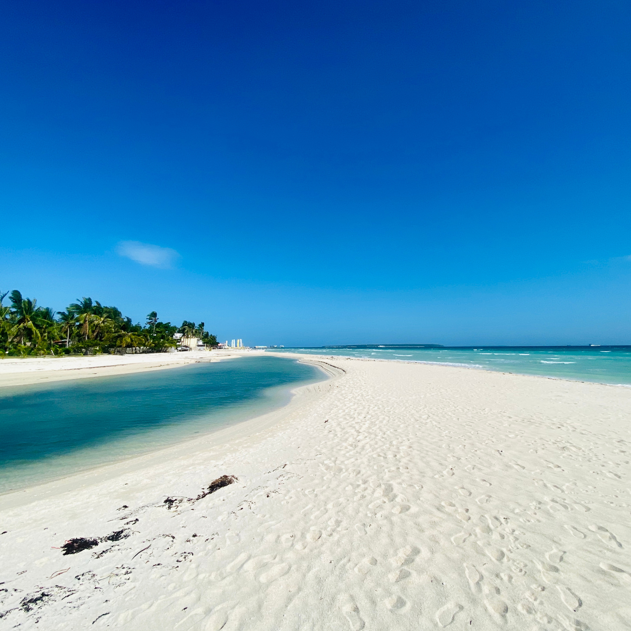

HOME
ABOUT
SERVICE
TRAVEL PLAN
https://traveltriangle.com/tour-packages/Singapoor
NEXT >

Slide 4
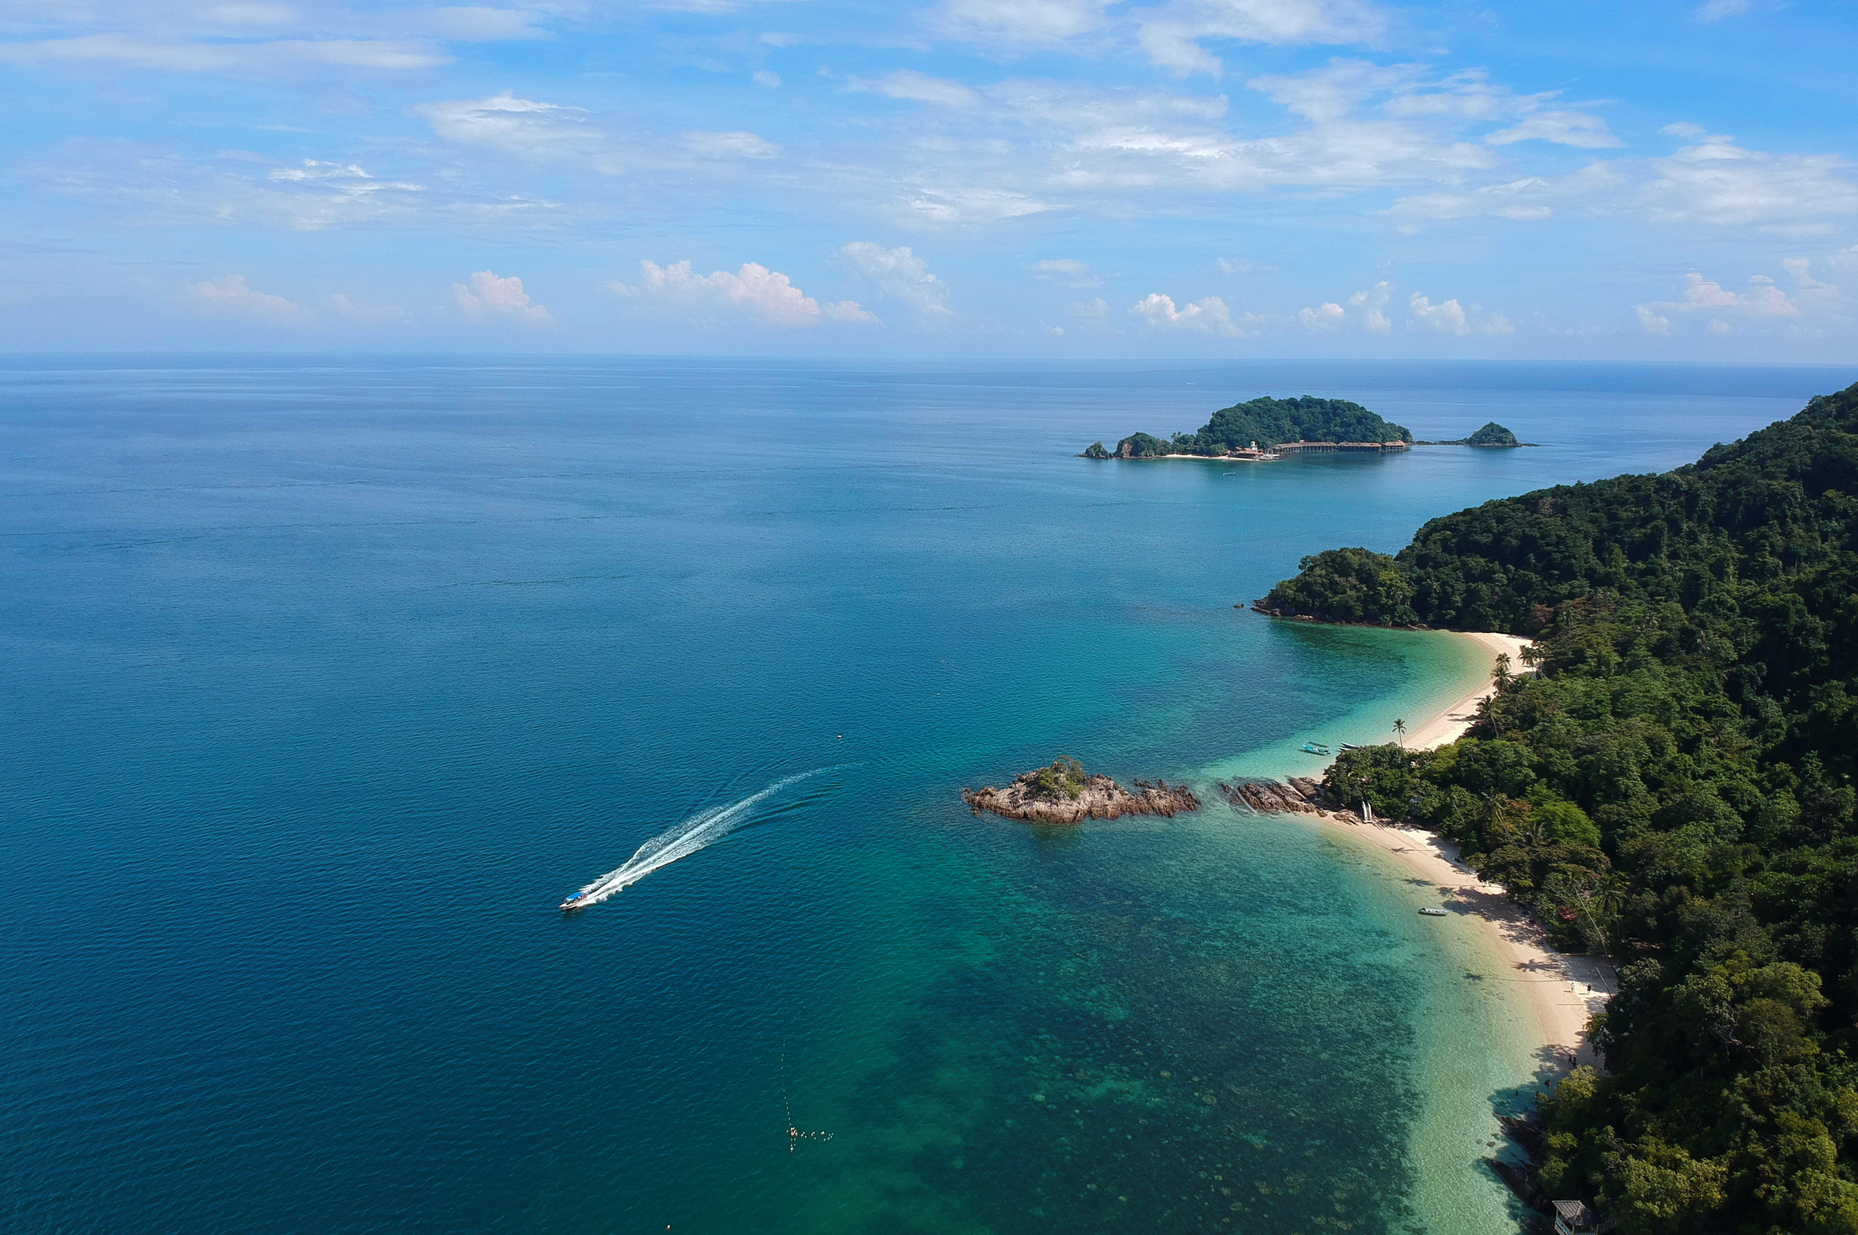
INTRODUCTION
Travel Triangle is an online platform for booking customizable holiday packages planning something.
It connects travelers with verified local travel agents for better planning.
Offers a wide range of tours: family, honeymoon, adventure, beach, luxury etc.
Provides transparent pricing with discounts and seasonal offers to best place.
Users can filter by destination, duration, budget, and tour type.
< BACK
NEXT >

Slide 5
OBJECTIVE
The objective of this project is to perform exploratory data analysis (EDA) on a tour package dataset to:
Understand trends in travel durations, prices, and discounts.
Identify the most popular tour types and top travel destinations.
Analyze savings patterns offered to customers across different packages.
Detect and treat outliers to improve data quality and insight accuracy.
Support data-driven decision making for tourism companies and customers.
< BACK
NEXT >

Slide 6
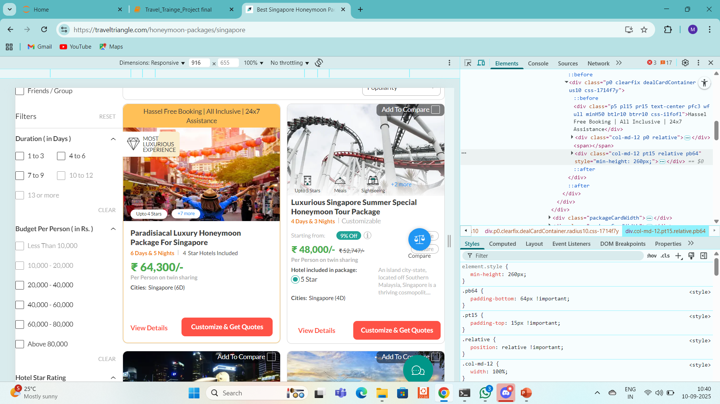
WEB SCRAPPING
URL:-https://traveltriangle.com/honeymoon-packages/singapore
Scrapped Data From Travel Triangle
< BACK
NEXT >

Slide 7
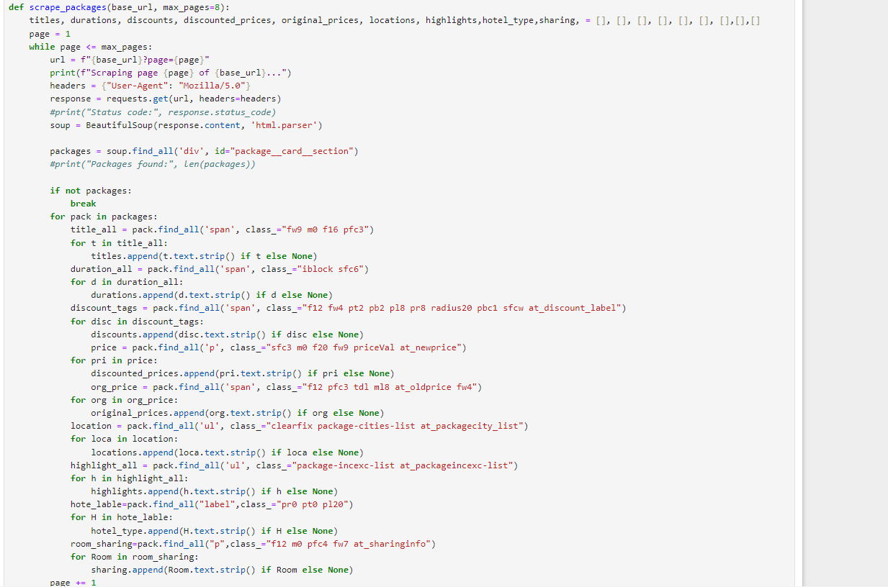
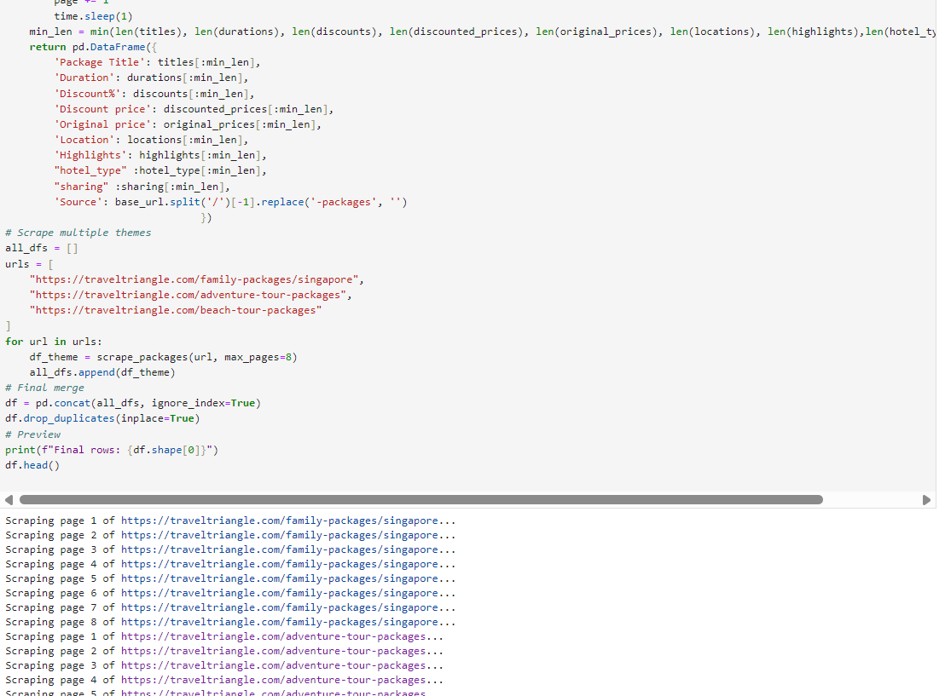
DATA COLLECTION
Data was scraped from the Travel Triangle website using Python and Beautiful Soup.
Multiple category pages were scraped — including Family, Adventure, and Beach Tours.
Extracted key information like:
Package Title, Duration, Discount, Price, Location, Highlights, and Tour Type
Looped through multiple paginated URLs to collect more than 400 tour packages.
BACK>
NEXT >

Slide 8
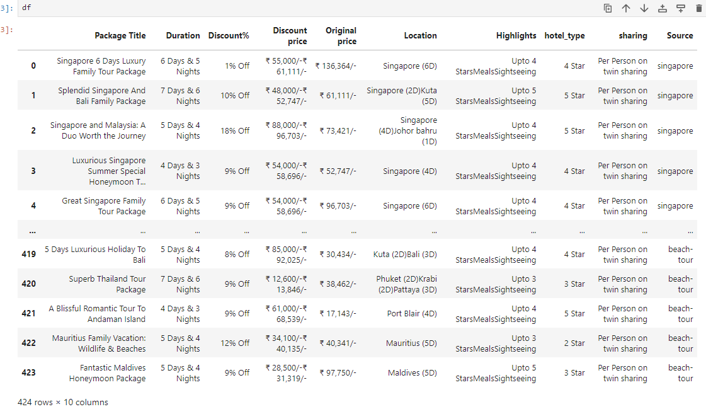
RAW DATAFRAE

Slide 9
DATA CLEANING
Extracted Days and Nights from the Duration column and converted them to numeric values.
Cleaned the Discount% column by removing text like % Off and converted it to float.
Fixed the Discount price column by extracting only the correct ₹ price.
Created a new column Amount Saved = Original price – Discounted price.
Cleaned the Location column by removing extra duration info and unnecessary spaces.

Slide 10
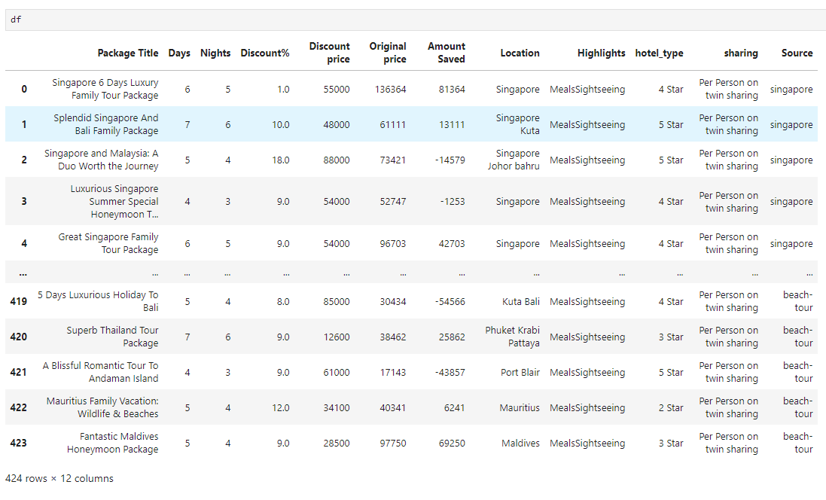
CLEANED DATAFRAME

Slide 11
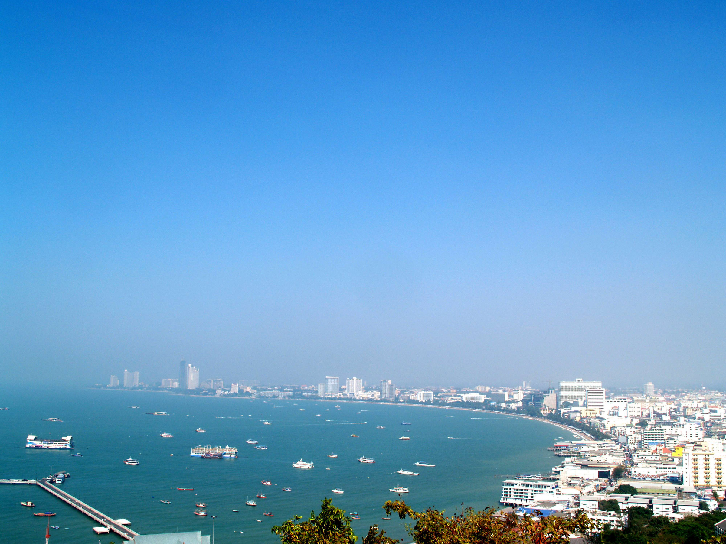
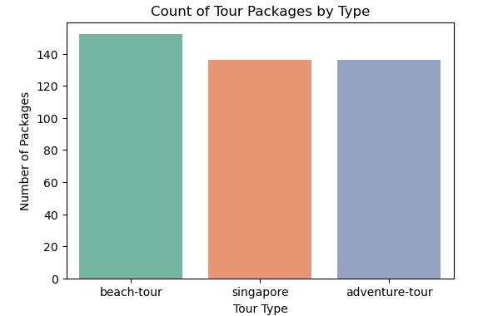

UNIVARIATE ANALYSIS
What is the most popular Tour Type?
Total packages are categorized into Singapore, Beach, and Adventure tours.
Beach tours have the highest number of packages.
Singapore and Adventure tours are also well-represented.
👨‍‍
🌊
< BACK
NEXT >
Family
Adventure
Beach Tour

Slide 12
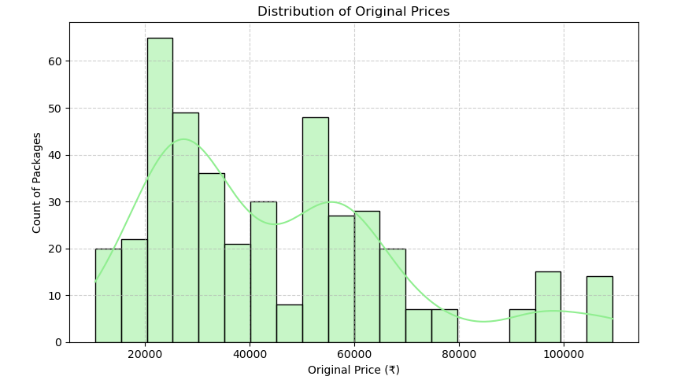
Distribution of Original Price
Most packages are priced between ₹15,000 and ₹40,000.
The price distribution is slightly right-skewed.
A few outlier packages go beyond ₹80,000 to ₹ 1,10,00.

Slide 13
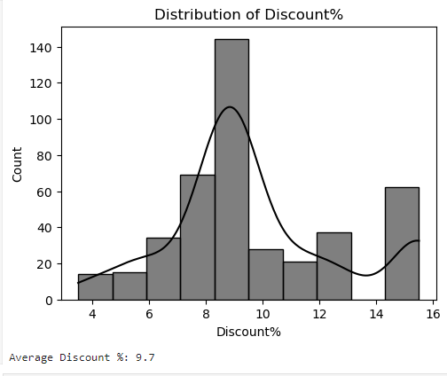
What is the average Discount Percentage?
Most discounts are between 7% to 10%.
Average discount is around 9.7%.
The distribution is approximately normal but slightly skewed..

Slide 14
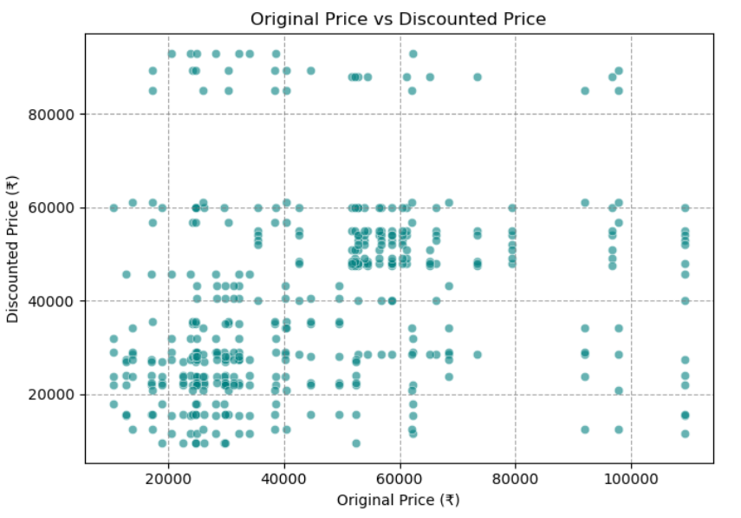
BIVARIATE ANALYSIS
Is there a relationship between original price and discounted price?
There is positive relationship between original and discount prices.
Most data points are concentrated at lower prices (~₹10,000 to ₹40,000).
Helpful for identifying luxury vs budget segments.

Slide 15
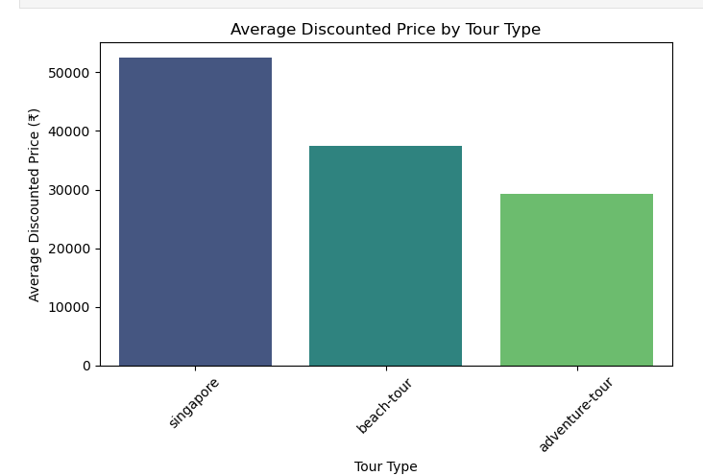
Which tour type has the highest average discounted price?
Singapore tours have the highest average discounted price (₹52,000+), targeting premium travelers.
Beach tours are mid-range, offering(₹37,000) a balance between cost and experience.
Adventure tours are the most affordable, great for budget-friendly travelers.

Slide 16
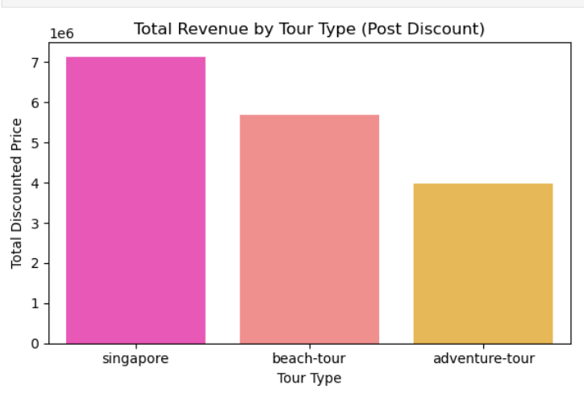
MULTIVARIATE ANALYSIS
Which Tour Type Generates the Most Revenue?
singapore tours generated the highest revenue (~₹7 Lakhs).
Beach tours follow with ~₹5.7 Lakhs in sales.
Adventure tours earned ~₹4 Lakhs.
Indicates strong demand for singapore destinations.

Slide 17
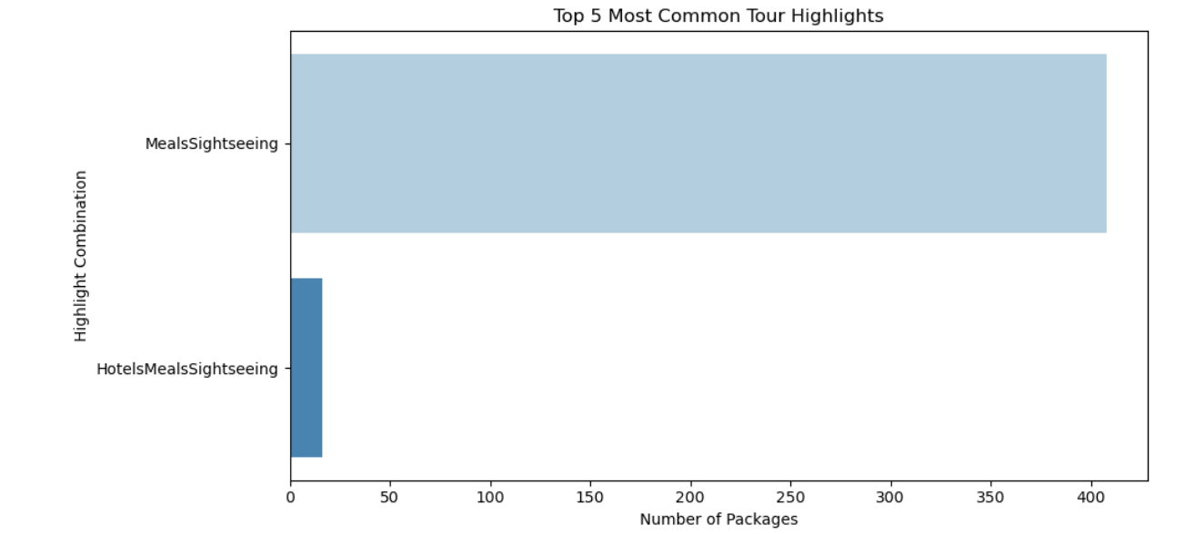

What are the Most Common Tour Highlights?
Meals and Sightseeing appear in most tour packages.
Some packages also include Hotels as an extra benefit.
Indicates travelers value basic comfort and guided experiences.
Food & drinks

Slide 18
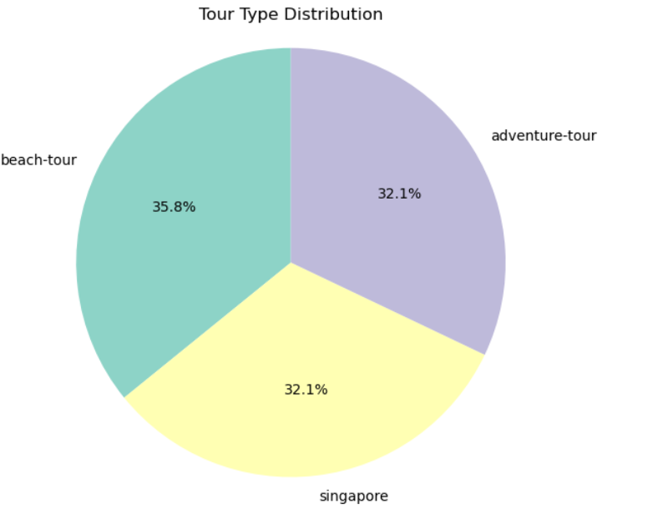
Which type of tour package is most common?
beach-Tour Package appear in most tour packages.
slightly more than Singapore and adventure , All three tour types are almost evenly distributed.
which shows a balanced offering for different customer interests...
Food & drinks

Slide 19
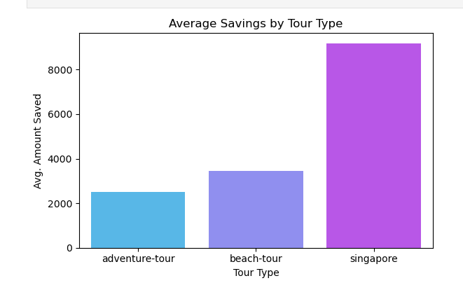
Which type of tour gives more savings?
Which type of tour package is most common?
Singapore tours offer the highest average savings (~₹9,200).
Beach tours moderate average savings (~₹3,400).
Adventure tours have lowest average(~₹2,500)..
Indicates strong demand for singapore destinations.

Slide 20
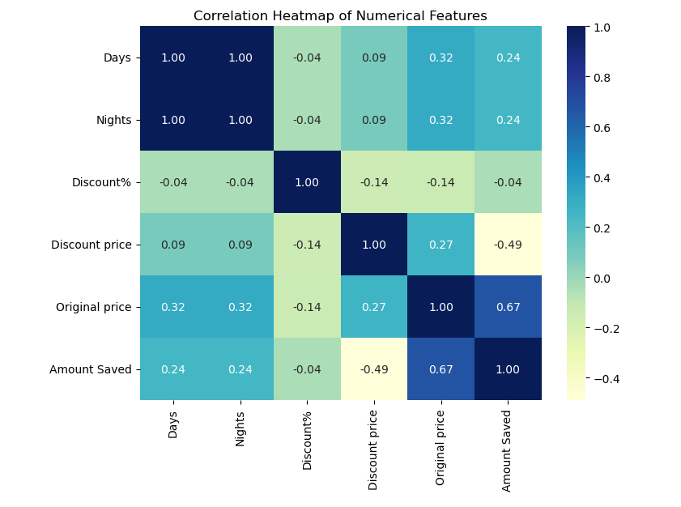
Correlation Heatmap
Days and Nights have a perfect correlation (1.00).
Original price and Amount Saved have a strong positive correlation (0.67).
Original price and Discount price show moderate positive correlation (0.27).
Discount price and Amount Saved have a moderate negative correlation (-0.49).
Discount% is weakly correlated with all other features (~ -0.14 to -0.04).

Slide 21
CHALLENGES FACED
Faced difficulty identifying correct class and span tags while scraping each column from the website.
Had to decide which columns were relevant to extract for the problem statement.
Data was in semi-structured format (inside nested <div> and <span>), not in a clean table, making scraping complex.
After scraping, data was raw — needed cleaning (e.g., removing ₹ symbols, %, unnecessary words).
Extracted Duration into separate Day & Night columns.
Ensured no null or duplicate values were present

Slide 22
CONCLUSION
Performed complete EDA on TravelTriangle tour packages including scraping, cleaning, and visual analysis.
Found key insights — Family tours give highest savings, Beach tours generate most revenue, and Meals & Sightseeing are top highlights.
These insights can help travel companies design better packages, offer smarter discounts, and target customer interests.

Slide 23
THANK YOU!

